Slide 1
Secondary Storage Management

Slide 2
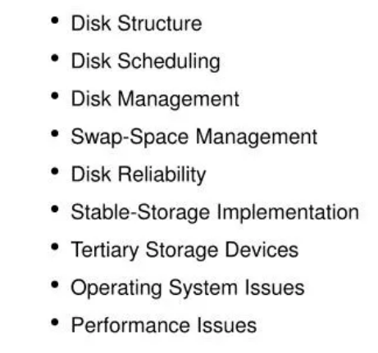
Secondary Storage Management

Slide 3
Disk Structure
Disk drives are addressed as large 1-dimensional arrays of logical blocks, where the logical block is the smallest unit of transfer.

Slide 4
Disk scheduling
The operating system is responsible for using hardware efficiently. For disk drives, this means having a fast access time and disk bandwidth.
Access time has two major components
Seek time is the time for the disk to move the heads to the cylinder containing desired sector.
Rotational latency is the additional time waiting for the disk to rotate the desired sector to the disk head.
Minimize seek time
Seek time is approximated to seek distance
Disk bandwidth is the total number of bytes transferred divided by the total time between the first request for service and the completion of the last transfer.

Slide 5
Disk Management
Low-level formatting, or physical formatting
This involves dividing a disk into sectors that the disk controller can read and write.
To use a disk to hold files, the operating system still needs to record its own data structures on the disk. Partition the disk into one or more groups of cylinders.

Slide 6
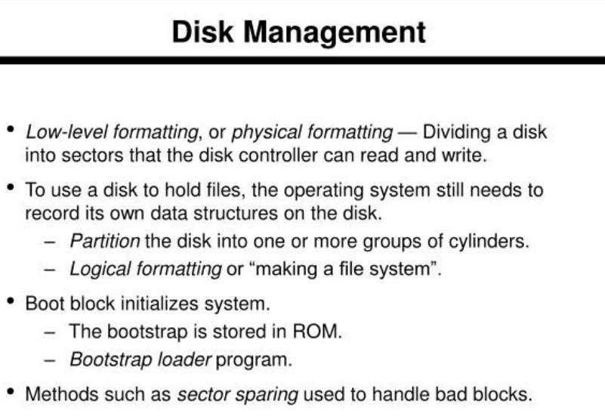

Slide 7
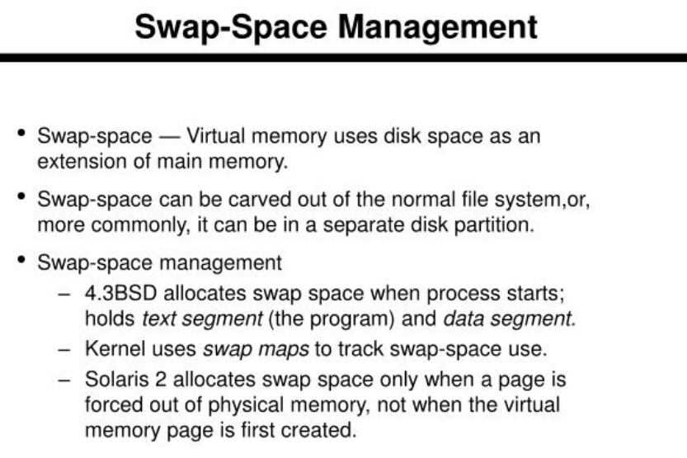

Slide 8
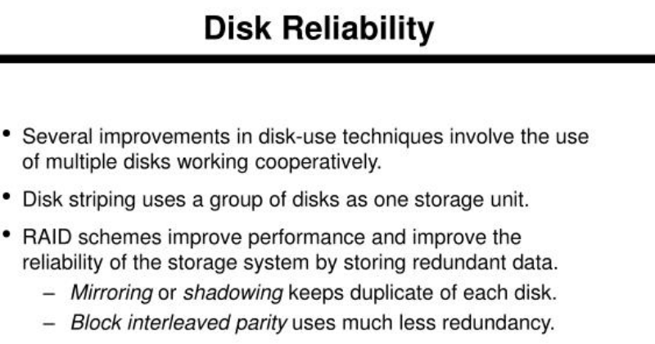

Slide 9
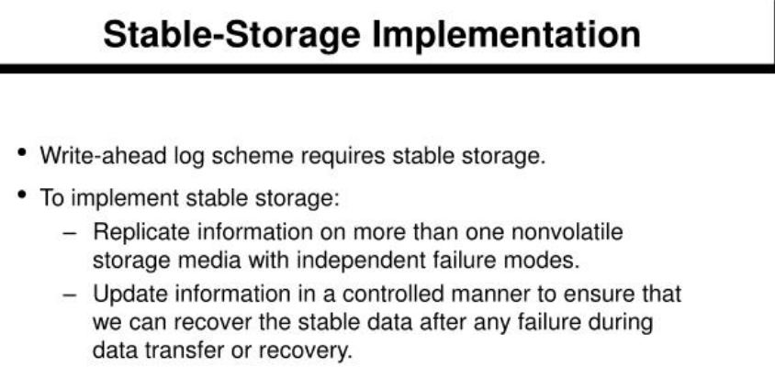

Slide 10
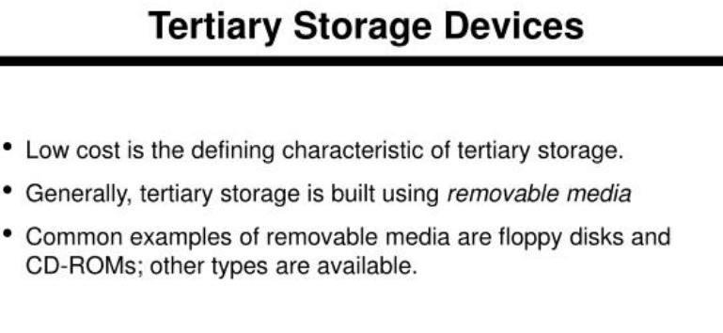

Slide 11
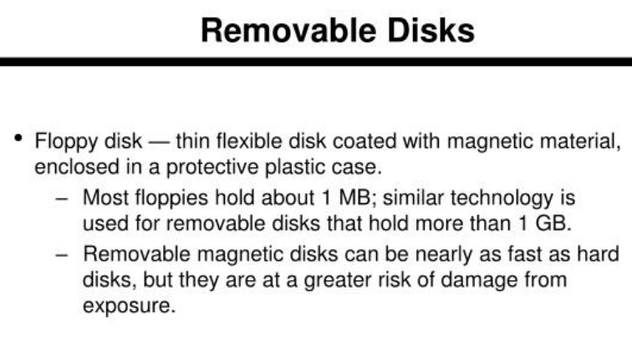

Slide 12
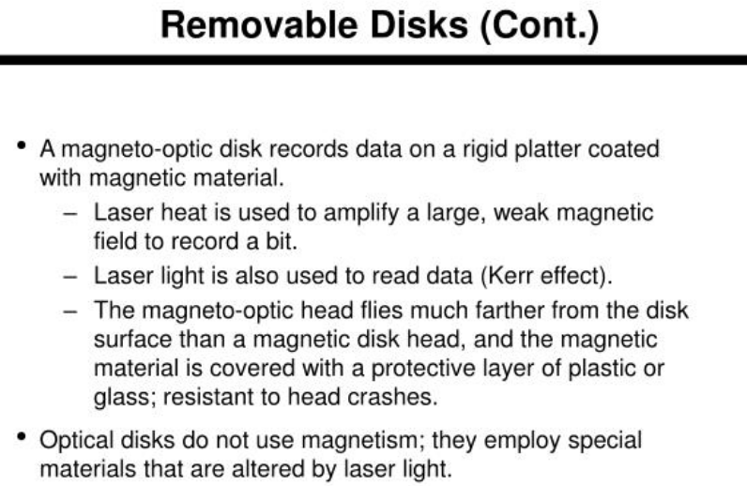

Slide 13
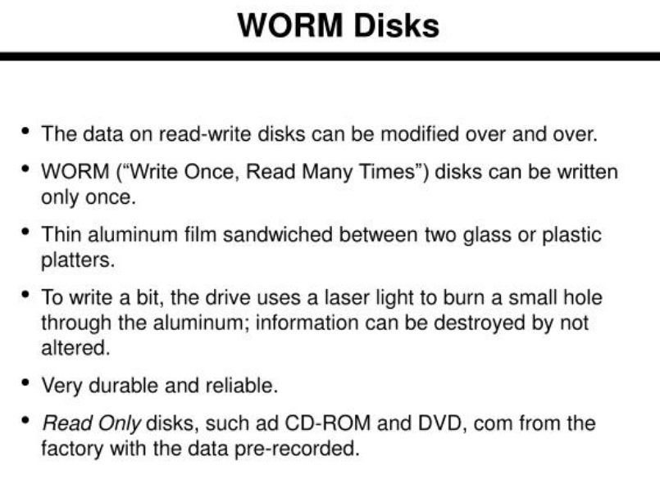

Slide 14
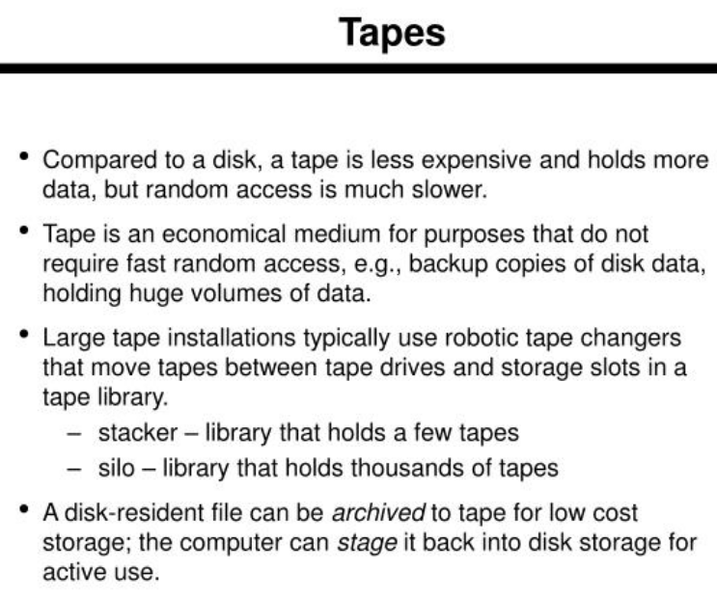

Slide 15
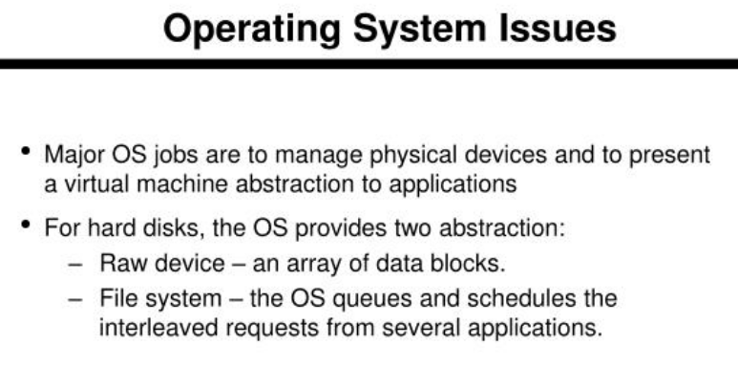

Slide 16
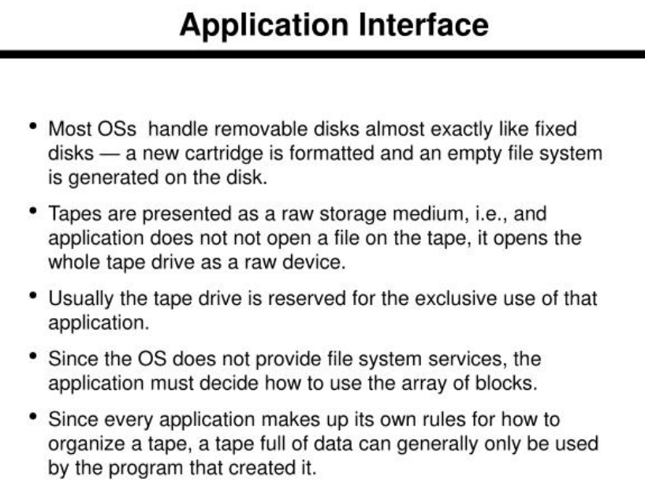

Slide 17
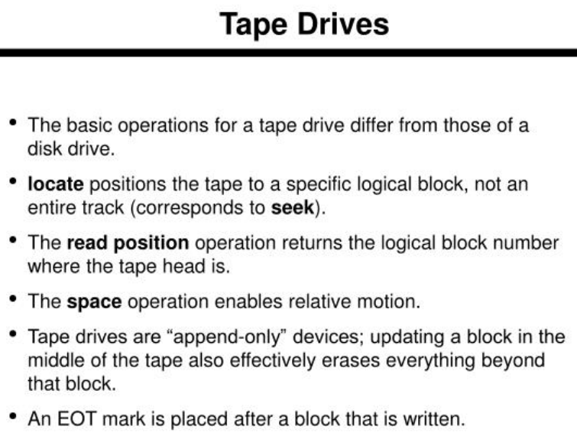

Slide 18
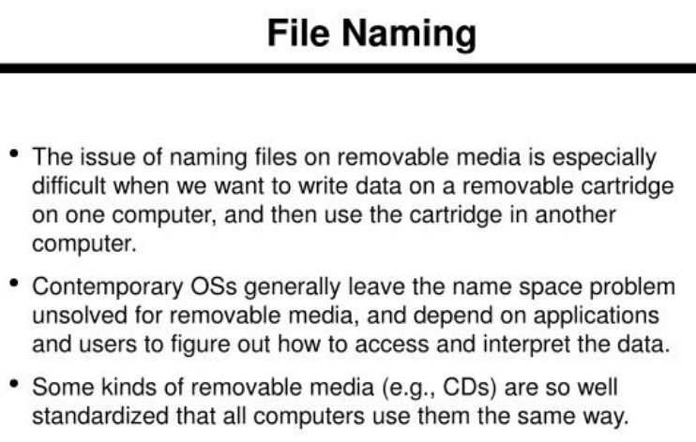

Slide 19
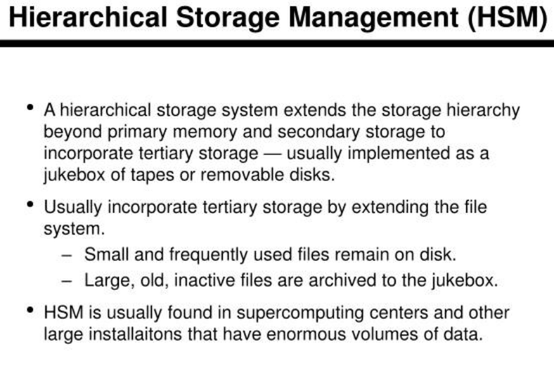

Slide 20
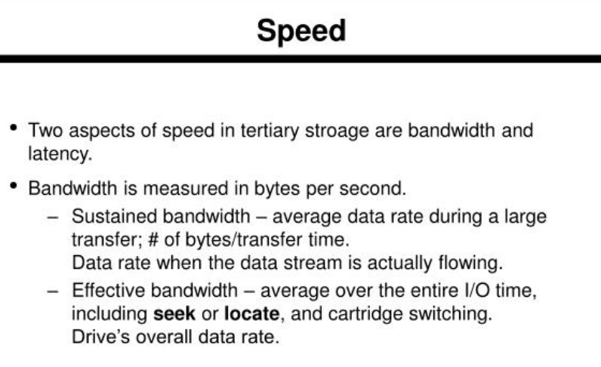

Slide 21
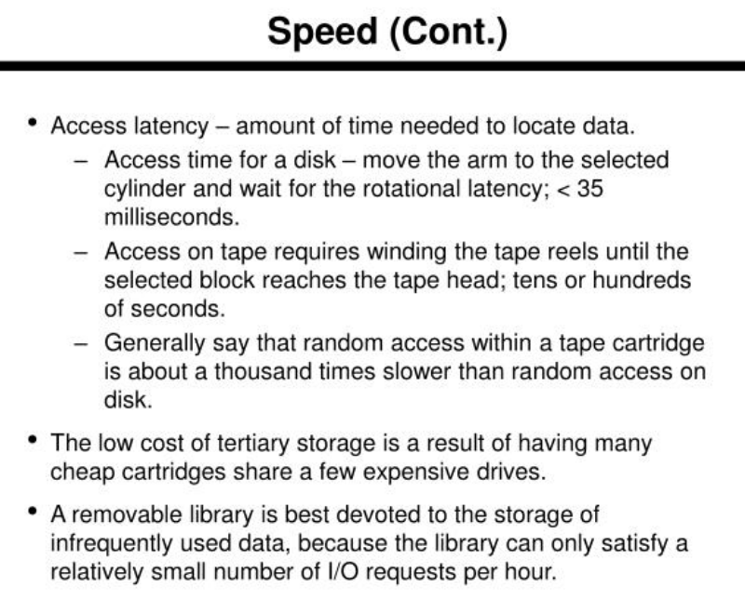

Slide 22
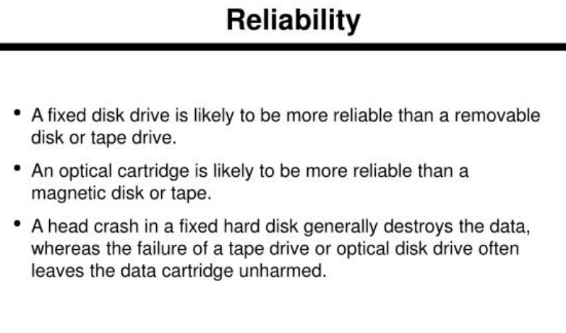

Slide 23
